Slide 1



Team - Hashira’s
Pulkit sharma (team lead)
Pratham chetal
Anand
Abhishek chauhan

Slide 2


Technology Used
SLACK BOT(PYTHON)
PYTHON (FLASK)
CLOUD COMPUTING(AWS)
AWS SERVER

Slide 3
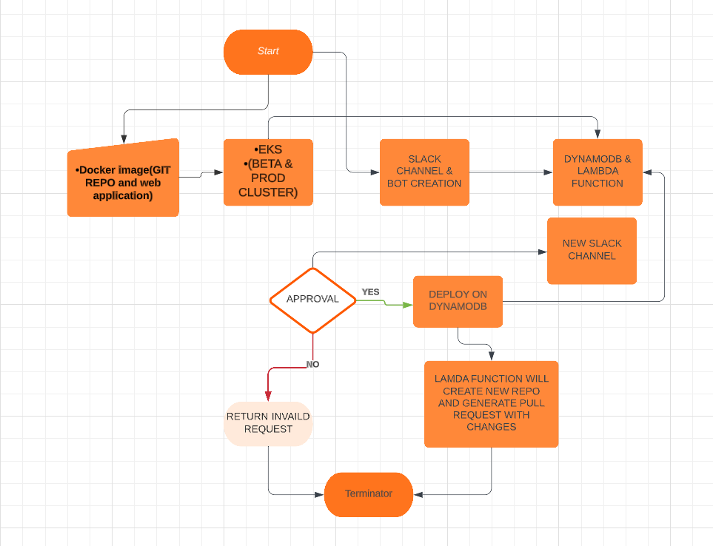
Process

Slide 4
PROJECT DESCPRITION
The flowchart describes the process of integrating a Docker image with Amazon EKS, Slack, AWS Lambda, and DynamoDB. It begins with creating a Docker image containing the application and dependencies, which is then stored in a Docker registry. An EKS cluster is set up on AWS to provide a managed Kubernetes environment. The Docker image is deployed to the EKS cluster using deployment tools like Kubernetes YAML files or Helm charts. Slack integration is established by creating or using an existing Slack workspace, where a Slack bot is created to handle incoming messages and trigger actions. AWS DynamoDB is utilized for storing data related to the Slack bot's functionality. An AWS Lambda function is created, triggered by specific events like receiving Slack messages or changes in the DynamoDB table. The Slack bot interacts with the Lambda function through API calls or events. Users interact with the Slack channel where the bot is installed, performing actions and sending messages. The Lambda function handles DynamoDB updates, performing CRUD operations. Changes made to the Lambda function or DynamoDB table are deployed, and continuous deployment can be implemented using CI/CD pipelines triggered by version control system commits.

Slide 5

Thank you
OUR EMAILS:
Pulkit0511.be20@chitkarauniversity.edu.in
Pratham0504.be20@chitkarauniversity.edu.in
Abhishek0517.be20@chitkarauniversity.edu.in
Anand1267.be20@chitkarauniversity.edu.in

